Slide 1


Achieve More with Less using Active Learning & Guided Search
Data Science Summit 2018 Workshop.
Omri Allouche & Tal Perry

Slide 2
Active Learning Omri Allouche
Guided Search
Tal Perry
Introduction to Active Learning
Motivation – why I became interested in Active Learning
Types of Active Learning
Hands-on session
Image classification – MNIST
Text classification – SM Spam
https://github.com/omriallouche/active-learning
Wrap up – pros+cons of active learning, suggested workflow
Coffee break
Introduction to Guided Search
Introduction to Elastic Search
Hands-on Session
https://github.com/LightTag/CAHLM

Slide 3





Omri Allouche
Tal Perry
Inbal Horev
Eran Marom
Yonathan Guttel

Slide 4
Credit, Thanks & Useful Links
Burr Settles -
Active Learning Survey http://burrsettles.com/pub/settles.activelearning.pdf
Dualist - https://github.com/burrsettles/dualist
Tal Perry (check out https://github.com/LightTag/active_learning_example/blob/master/papayas.ipynb)
Inbal Horev, Yonathan Guttel and Eran Marom
The DSS team
You

Slide 5


Dr. Omri Allouche
Head of Research, Gong.io
Teacher, Bar Ilan University

Slide 6

Notes:
כמו שציינתי אנחנו בעצם יודעים מי אנשי המכירות הטובים בארגון.
ואנחנו רוצים לדעת מה מבדל אותם משאר האנשים... ( על - כמה - מתי בשיחה)
זאת נקודת המפתח שלנו כדי לתת המלצות.

Slide 7
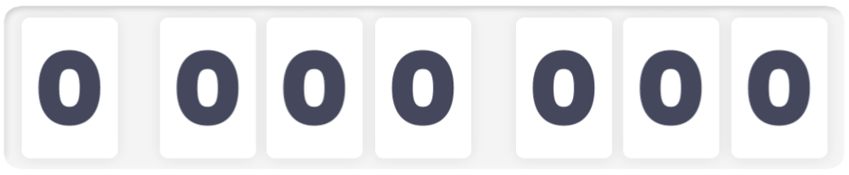
,
,

Slide 8



Record
Transcribe
Analyze

Slide 9
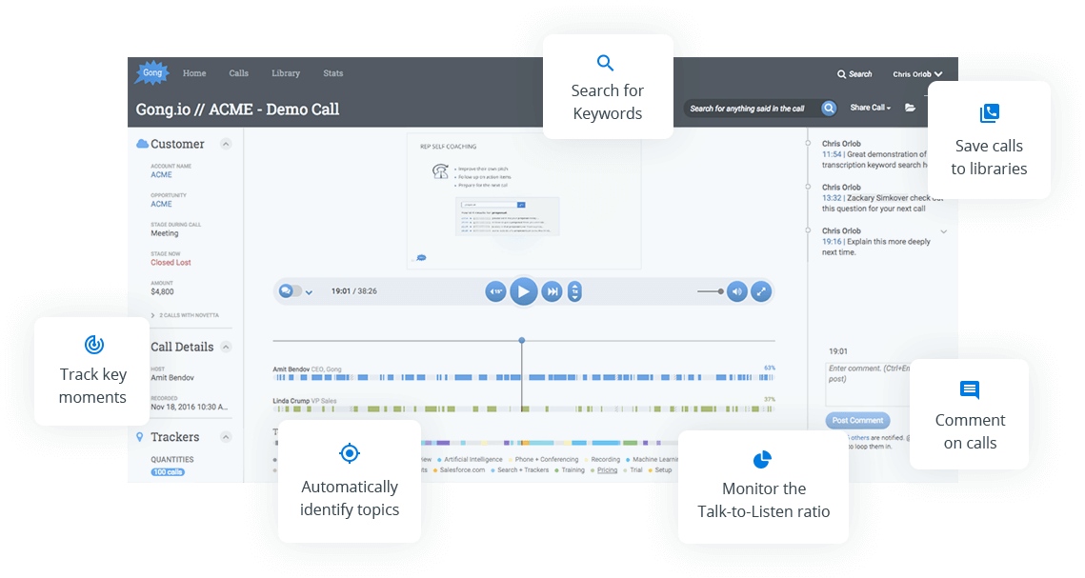

Slide 10

Teaching Machines is an Expensive Business…
Transcribing an hour of Speech ≈ $100
You need roughly 1,000 hours for descent performance = $100,000
Labeling a text sentence in FigureEight is ~10 cents
Binary Classification Tasks with ~1-5% prevalence of target class × 1,000 sentences = $10,000 per task
Annotating Sales calls requires domain expertise – hard to come by and expensive…

Slide 11

Action Items Detection
I will send you an email after the call Let’s touch base next Tuesday Let me share my screen...
Other features can indicate an Action Item:
Action items are mostly said by Sales Rep
Action items mostly appear at the end of the call
Action items are usually the last sentence in a paragraph

Slide 12
Action Items Detection
Many sentences are obviously not an Action Item –
Hey Josh. How are you?
Yeah, it’s been raining all day here.
Can you hear me?
…
We don’t want to spend precious labeling time on them
Claim: Even a basic model can detect if a sentence is:
Definitely an Action Item
Definitely not an Action Item
Might be an Action Item

Slide 13
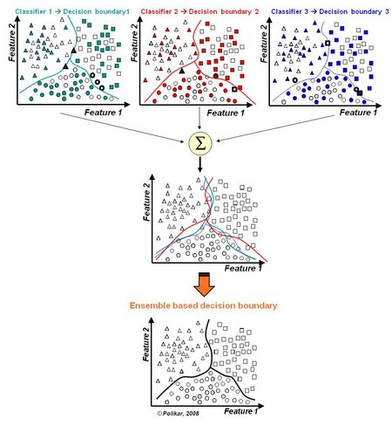
Concepts rooted in other Machine Learning concepts
SVM - Support Vector Machines – Decision boundary is set by Support Vectors – these points are the most informative
Ensemble Learning – Combine different models for a joint prediction, with higher accuracy.
Support vectors
Margin

Slide 14
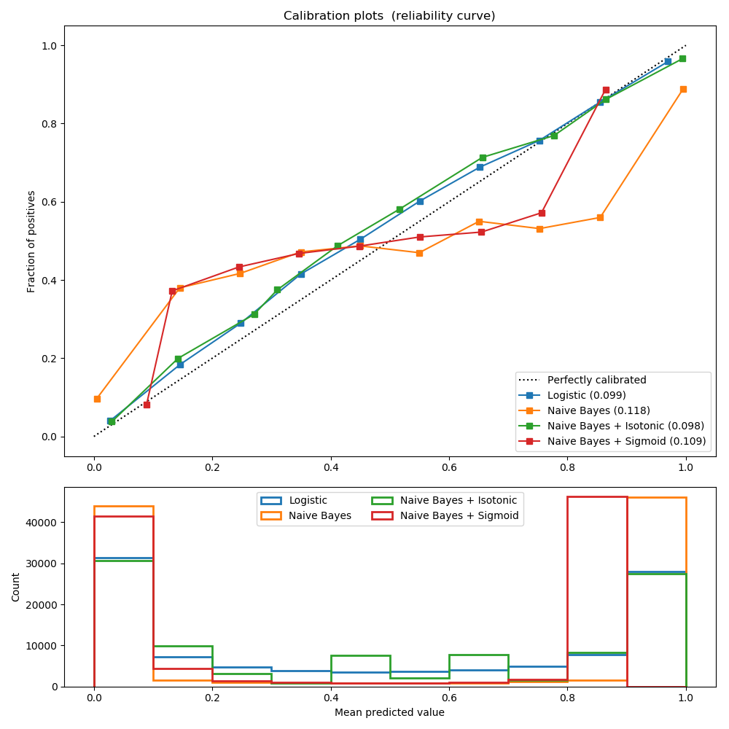
Concepts rooted in other Machine Learning concepts
Calibration Plots – Checking correspondence between predicted value and fraction of positives
(http://scikit-learn.org/stable/modules/calibration.html)
Notes:
http://scikit-learn.org/stable/auto_examples/calibration/plot_calibration_curve.html

Slide 15

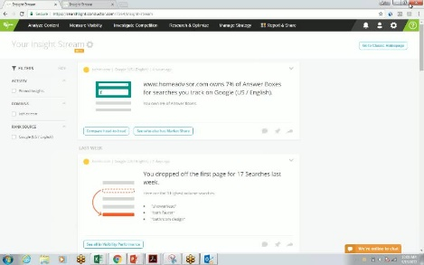
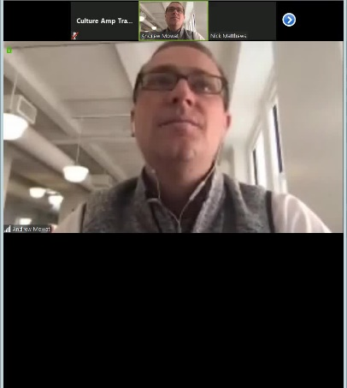
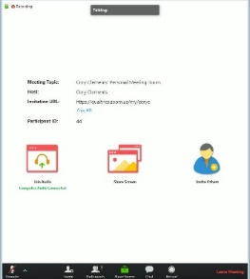
Video Frame Classification
Video recordings can be separated into 4 main categories:
Web cam
Browser demo
Presentation slides (ppt / Google slides etc)
Conferencing provider app (Skype / Zoom / GoToMeeting etc)

Slide 16
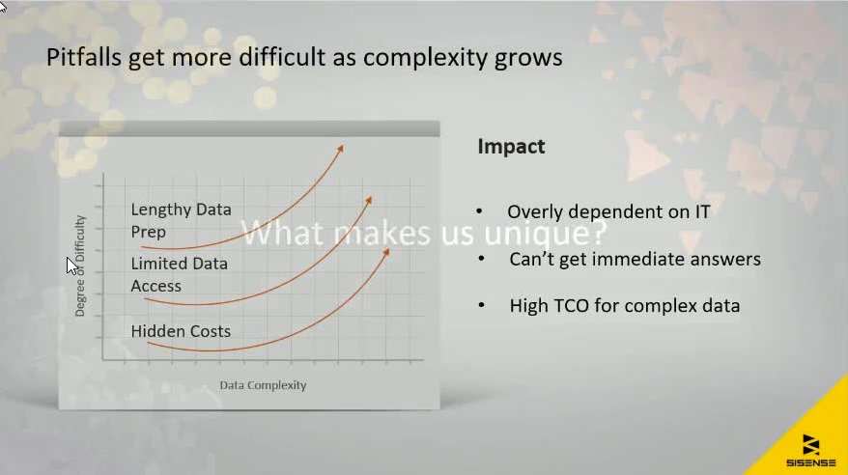
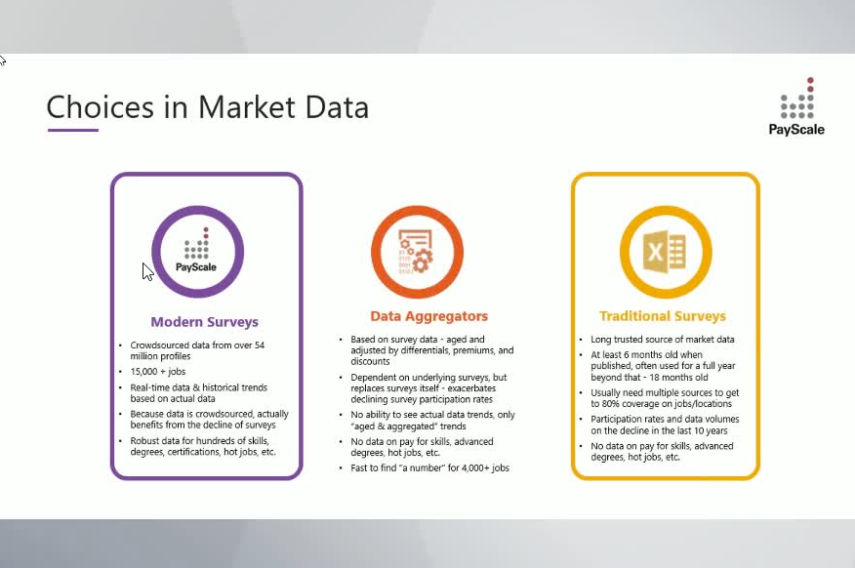

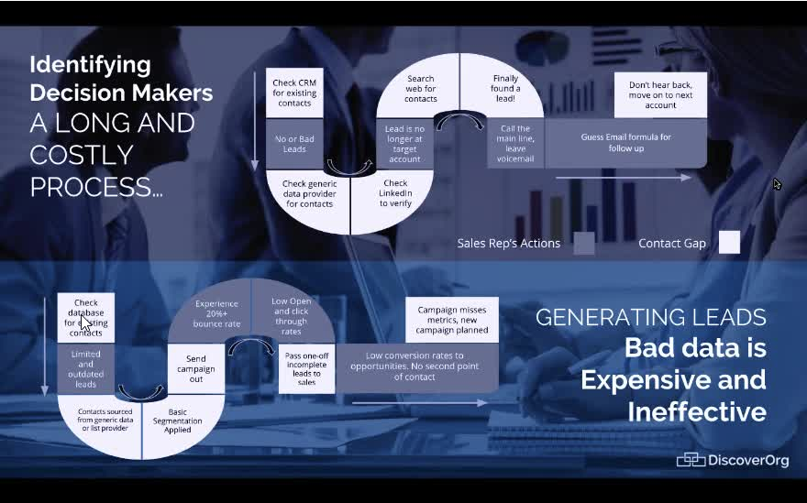
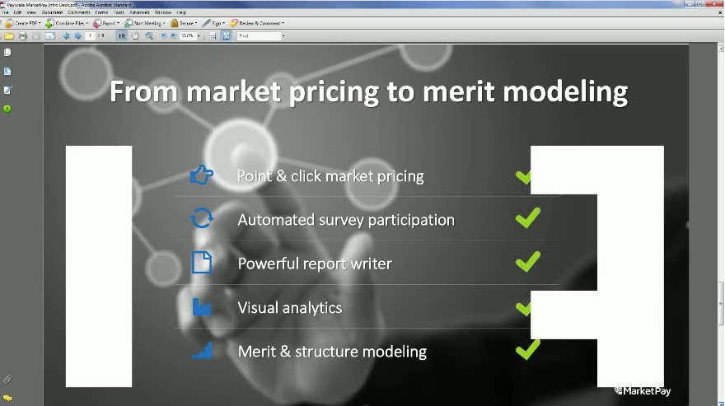
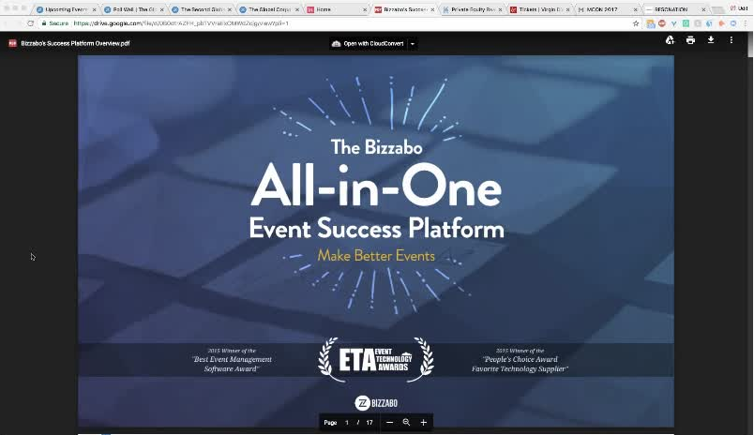
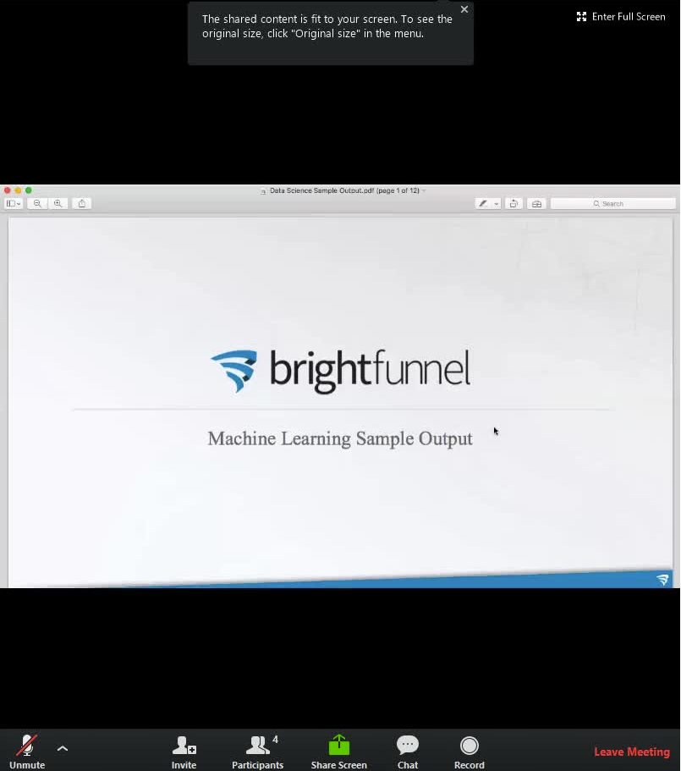

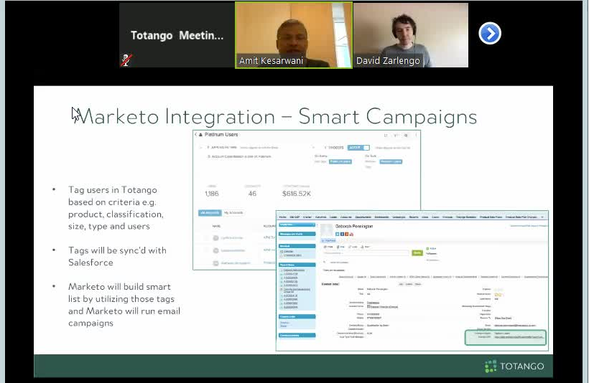
Low Confidence
High Confidence

Slide 17
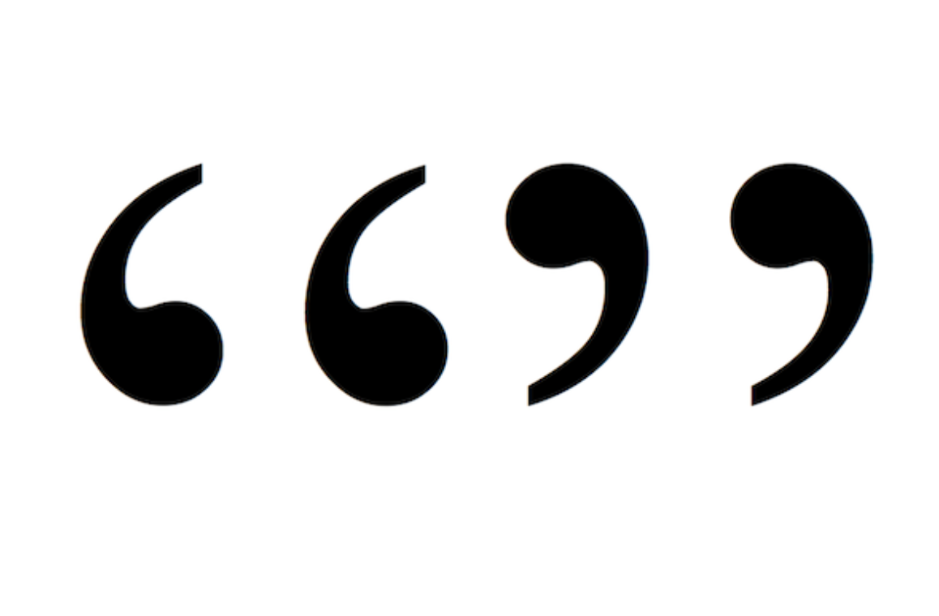
CrowdFlower changes its name to Figure Eight
The formal name change to Figure Eight is to better reflect the company's technology platform that combines the best of machine learning and human intelligence, rather than just using human intelligence to label data. The new name and identity brings into focus Figure Eight's core philosophy of human-in-the-loop practices being the essential ingredient to making AI work in the real world, specifically the iterative process of active learning for the training, testing, and tuning of machine learning models.

Slide 18
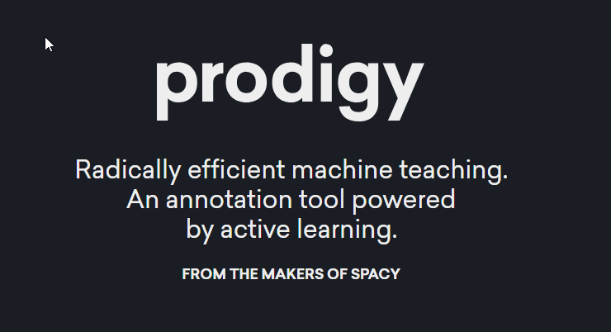
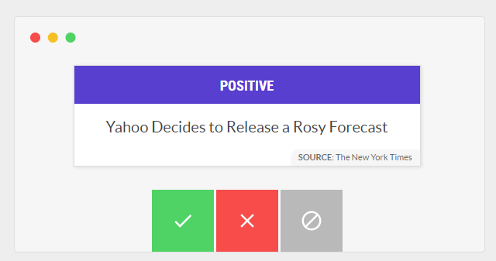

Slide 19
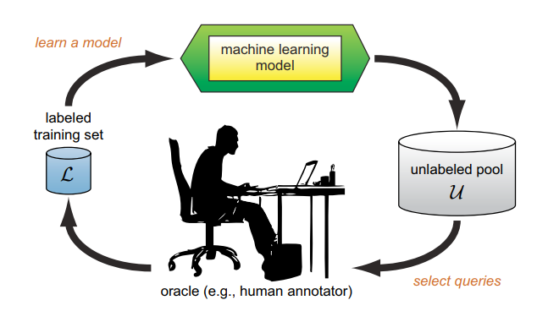
Active Learning – Basic Framework

Slide 20
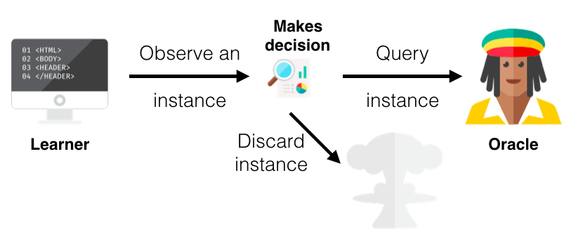
Stream-Based Selective Sampling

Slide 21
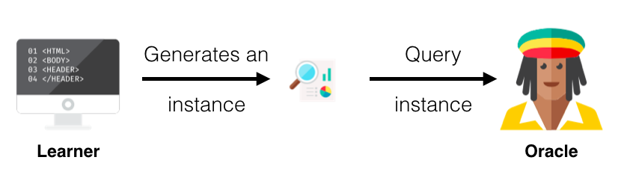
Membership Query Synthesis

Slide 22
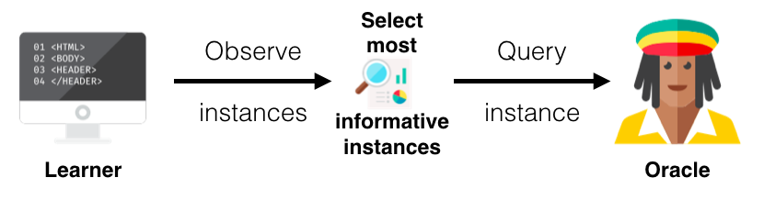
Pool-based Sampling
Single Instance / Batch

Slide 23
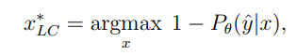
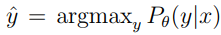
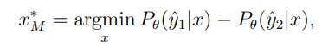
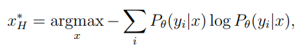
Active Learning Methods
Uncertainty Sampling
Label points with the lowest confidence for the predicted class
Margin Sampling
Label points with the lowest difference between confidence of predicted class and 2nd best class
Entropy Sampling
Label points with highest entropy for predicted classes
where and are the first and second most probable class labels under the model, respectively

Slide 24
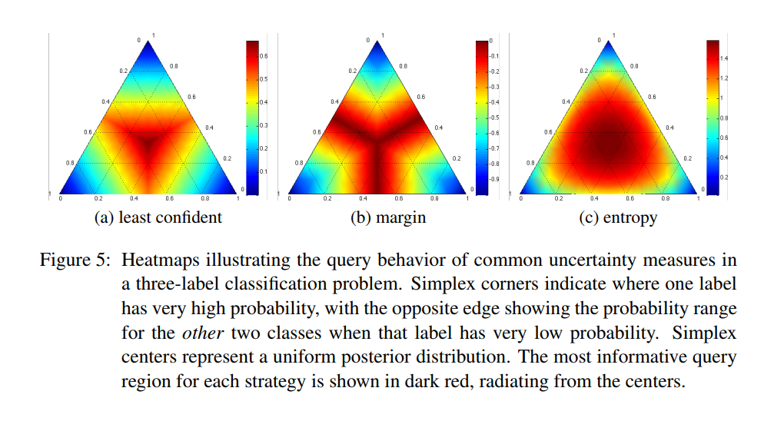
Credit: Burr Settles. Active Learning Literature Survey. Computer Sciences Technical Report 1648, University of Wisconsin–Madison. 2009.

Slide 25
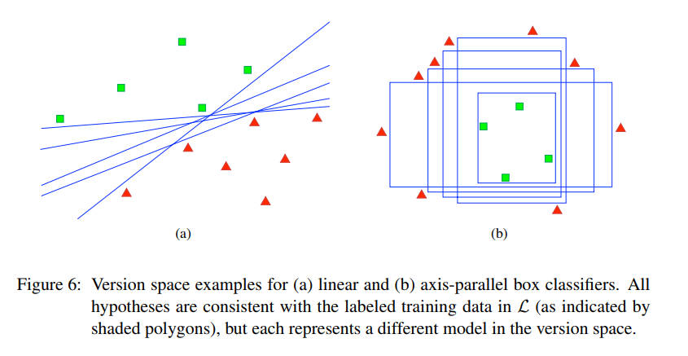
Active Learning Methods
Query by Committee
A variety of models are trained on the current labeled data, and vote on the output for unlabeled data
Label those points for which the "committee" disagrees the most

Slide 26
Active Learning Methods
Expected error reduction
Label those points that would most reduce the model's generalization error
Variance reduction
Label those points that would minimize output variance, which is one of the components of error

Slide 27
Active Learning Methods
Balance exploration and exploitation
Choose examples to label as a trade-off between exploration and exploitation of the data space
This strategy manages this compromise by modelling the active learning problem as a contextual bandit problem.
For example, Bouneffouf et al.[7] propose a sequential algorithm named Active Thompson Sampling (ATS), which, in each round, assigns a sampling distribution on the pool, samples one point from this distribution, and queries the oracle for this sample point label.

Slide 28
Using Unlabeled Data
"Believe in yourself" - Bootstrapping
The number of labeled instances is often too small for proper classification
Better performance are obtained when weighting labeled instances with unlabeled instances
Running EM several times improves performance
Biggest gain is achieved on the 1st run of EM - for performance, run EM only once

Slide 29
Active Learning Theory
Select instances according to
Informativeness
Representativeness
Diversity
How to select seed?
Represent all classes
Perhaps first cluster and select from different clusters
Start with potentially difficult set (e.g. "I will" for Action Items)
Consider class priors

Slide 30
Today’s Agenda – Active Learning Part
2 Datasets –
Image - the MNIST digits dataset
Text – spam/ham text messages
Train a simple Logistic Regression model
Check if model confidence correlates with its performance
Train several models (LR, KNN, SVM), and check when they agree/disagree
(Finally!) Test it ourselves - can Active Learning improve our performance?

Slide 31
Today’s Agenda – Active Learning Part
(Finally!) Test it ourselves - can Active Learning improve our performance?
We set an initial batch for labeling
We then select N new examples and ask the Oracle for their true label
We train a model on examples with labels
Repeat steps 2-3

Slide 32
Omri Allouche
Tal Perry
Inbal Horev
Eran Marom
Yonathan Guttel

Slide 33
Criticism against Active Learning
Selected instances often tied to chosen algorithm
Do instances selected because of one model’s confidence be helpful for a different model?
Selected instances are a biased distribution of population
Performance depends on the proficiency of annotator
Labelers tend to make mistakes for “difficult” instances

Slide 34
Proactive Learning
Set to relax the unrealistic assumptions of Active Learning
Oracle may be wrong
especially when question is more difficult
Oracle may be reluctant to answer
Cost of labeling increase for difficult questions
Donmez, P., Carbonell, J.G. (2008) Proactive Learning: Cost-Sensitive Active Learning with Multiple Imperfect Oracles

Slide 35
When Active Learning is a Bad Choice
Training takes very long
Labeling is very cheap
Classes are well-balanced
You are unsure regarding your choice of algorithm
There's no correspondence between model confidence and performance

Slide 36
Why Active Learning didn’t Take Off
In Academia –
Challenges include labeled instances and focus on overall performance, without considering the number of labels used
When creating your own dataset, you select instances that are “interesting”
While labeling often requires only a simple share of a file, Active Learning requires an interactive platform
UI
Server
Results aren’t very robust (as our hands-on work shows), and depend on the algorithm
There’s no foolproof “Recipe” for Active Learning

Slide 37
Suggested Workflow
Collect a small set of labeled instances using “Guided Search”
Use domain knowledge
Use statistics to propose candidates that a human can label
Build a basic model, and evaluate performance
Learning Curve
Correlation between confidence and performance
Review manually instances with low confidence – there are often labeling mistakes there
Decide where to invest your efforts
Fix errors with a rule-based model
Enlarge training data – use model confidence to highlight good candidates for labeling
Increase training set randomly
…

Slide 38

Time for more coffee!
We’re hiring!
- Full-stack Java Engineers
- Machine-learning Engineers
- Data Scientists

